Slide 1
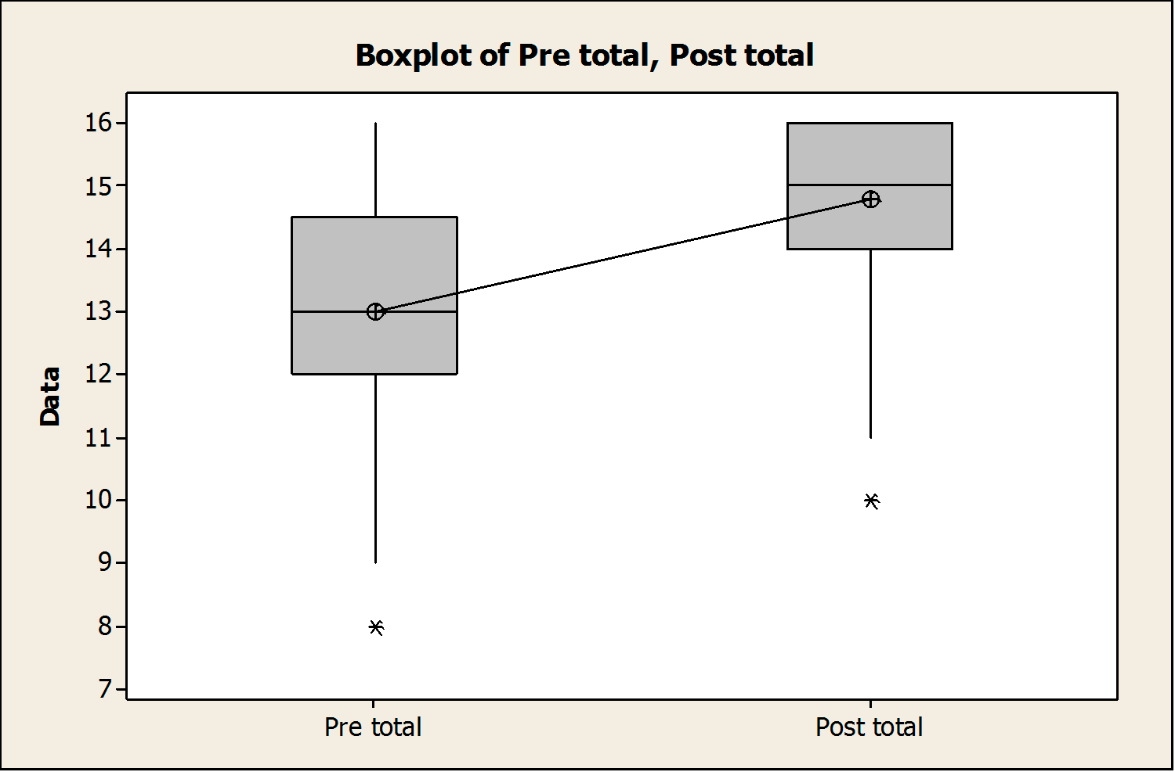
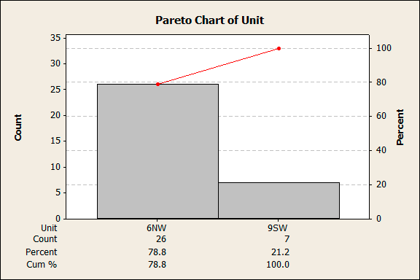
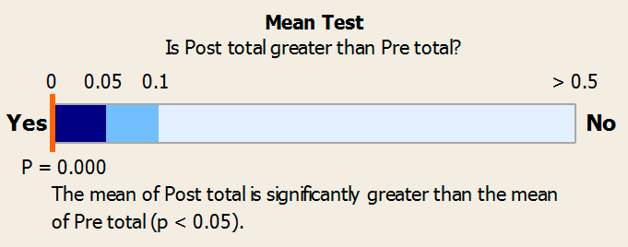
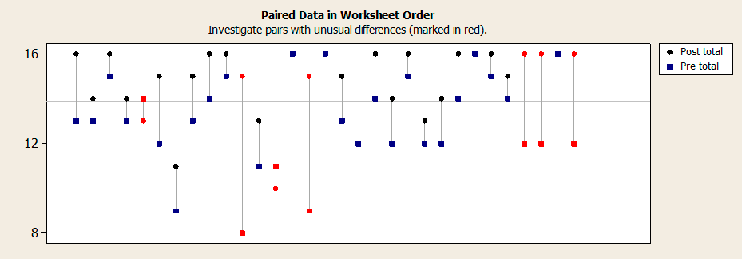
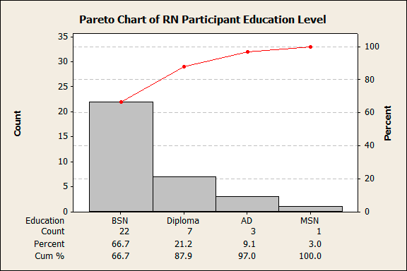
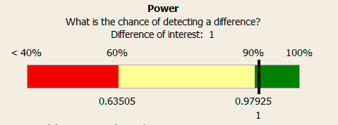
Assessment Skill Training with the Ventriloscope® and the Need for Emergency Intervention on Medical/Surgical Units
Sally Bennett, PhD, RN-C; Mary Beth Bidlack, BSN, RN; Patricia Cavanaugh, RN; Sandra Congdon, BSN, RN, CPN; Scott Kopatz, RN; Daisy Matulevich, BSN, RN; Tanya Seymour, MS, RN, CCRN; Paul Lecat, MD
Guthrie Robert Packer Hospital, Sayre, PA
Background Methods Results
Findings
The struggle to teach physical diagnosis skills has become even more difficult, despite advances in technology
Assessment of continued competence among nursing staff related to physical assessment skills offers many of the same challenges
The utilization of simulation along with other learning formats, such as standardized patients, offer an effective means of determining continued competency (Decker, Utterback, Thomas, Mitchell & Sportsman (2011). Such evaluation allows for an integrated evaluation of skills performance, learner satisfaction, critical thinking and self-confidence (Decker, et.al, 2011)
The Ventriloscope® (Castilano et al, 2009) is a novel device that can place any sound wirelessly into a learner’s stethoscope anywhere on a live patient or mannequin for teaching, testing, or simulation purposes
It is proposed that learning abnormal physical exam sounds in the context of a live patient, who can also give a medical history, will be an effective way of acquiring critical auscultation skills, as opposed to standard teaching techniques (i.e. live patients with or without findings are used; sounds are learned in an abstract fashion, apart from a patient)
Subjects Demographics
Registered Nurses (RN) from two Medical/Surgical Units who were participating in a clinical competency evaluation involving simulation were invited to participate in this study
Hypotheses #1-4 were rejected, as there were no significant findings among Rapid Response and Code Blue calls after the intervention
Hypothesis #5 was accepted
 | N | Mean | St Dev | Median | Range
Experience in Nursing (months) | 33 | 108.4 | 155.1 | 30.0 | 1-525
Experience on Unit (months) | 33 | 28.79 | 33.61 | 22.0 | 1-144
Telemetry/Cardiac Unit - 6NW
Respiratory/Burn Unit - 9SW
RN participants did report a positive experience as a result of participating in the study
Confidence scores were significantly higher post intervention
A total of 33 RNs participated
Study Intervention
Before beginning the clinical competency, RNs received instructions about the simulation stations
At this time, they were informed of the option of participating in a nursing research study in conjunction with the educational intervention
Those interested in participating were asked to complete an eight question survey
All RNs rotated through four stations with standardized patient actors portraying clinical scenarios
Study Objectives
Myocardial infarction
Septic shock
Respiratory failure
Stroke
To evaluate the effectiveness of an educational intervention for medical/ surgical nurses on the incidence of unit based Rapid Response Team Calls and Code Blue events on medical/surgical nursing units
The teaching intervention is the Ventriloscope® in combination with standardized patient actors, to teach recognition of clinically critical patients on medical/surgical floors earlier, using physical finding recognition skills
Secondary objectives include evaluating a nurse skill set that would assist them in acting upon the critical situation, as well as effectively handling difficult work situations in order to seek proper and expedient care for their patient
This evaluation includes assessment of skills performance, learner satisfaction, critical thinking and self-confidence
The actors were trained to use the Ventriloscope® to play appropriate heart, vital sign, and lung sounds for their clinical condition
The RN assessed the situation as they would on their unit and responded in a similar manner, including a mock call to a supervising nurse and/or physician
Communication with supervising staff and physicians included situations ranging from straightforward to difficult
Assessments of the nurse was made of his/her actions, documentation, communication with staff, and attention to patient
Debriefing with scenario facilitator and RN occurred after each station to provide feedback regarding their performance during the competency assessment
After completing all four stations, nurses interested in participating in the study completed four written surveys (National League for Nursing, 2005; Reese et al, 2010)
Hypotheses
The incidence of Rapid Response Calls on 6NW will decline after the educational intervention with the Ventrioloscope
The incidence of Code Blue Calls on 6NW will decline after the educational intervention with the Ventrioloscope
The incidence of Rapid Response Calls on 9SW will decline after the
Study Measures
Study Pretest of Confidence, including demographic information
Educational Practices questionnaire
Satisfaction and Self Confidence in Learning instrument
Simulation Design Scale
Study Posttest of Confidence, excluding demographic information
Study Instruments assessed both personal learning experience and the simulation training
A post test with the same four questions regarding confidence as the pretest were administered a second time for the purpose of comparison
Additionally, unit specific data regarding the incidence of Rapid Response Team and Code Team (Code Blue) calls were collected six months pre and post intervention
educational intervention with the Ventrioloscope
The incidence of Code BDlueiCsalcls lono9sSWuwrilledecline after the educational intervention with the Ventrioloscope
Registered Nurses participating in the educational intervention with the Ventriloscope will report a positive learning experience
Disclosure
The study was supported by the RPH Nursing Research Council and the University of Akron, Akron, OH

